Slide 1
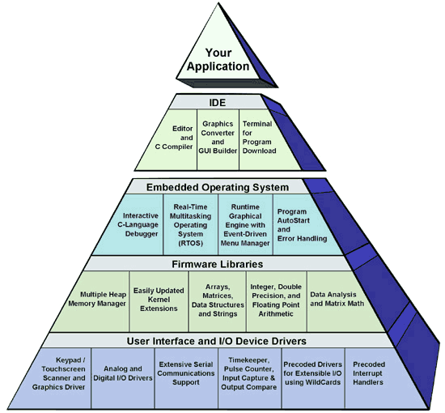
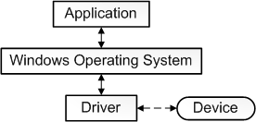

Device Drivers for Embedded Internet of Things (IoTs) Platforms

Slide 2
Content
Device Driver Overview
Serial Communication Device Driver
Universal Asynchronous Receiver/Transmitter (UART)
Serial Peripheral Interface (SPI)
Inter-Integrated Circuit (I2C)
Summary

Slide 3
What is Device Driver?
Device driver is a particular software application that is designed to enable interaction with hardware devices.
Device drivers are operating system-specific and hardware-dependent.
For embedded platforms running OS, device drivers are considered as part of firmware.
Firmware is the software which executes on the embedded system's CPU (written in assembler and C), was complied and the binary burned onto an EPROM.

Slide 4
Why Do We Need Device Driver?
Provide uniform APIs to access hardware.
Custom platforms
Contain many peripheral devices and kernel supported CPU
Get kernel to boot on the board
Device drivers to allow applications to access peripheral devices

Slide 5
Device Driver Models
Device drivers, over the years, have become very complex
Drivers are separated into classes
Serial, network, audio, video, touch panel, etc.
Layer approach is used
To support a new device, a layer is modified instead of rewriting the entire driver
Processing functions required for a given class often do not require modification

Slide 6
Device Driver Architecture
Device Drivers
Interrupt Service Threads
User Mode
Kernel Mode
Interrrupt Service Routines
Kernel
HAL

Slide 7
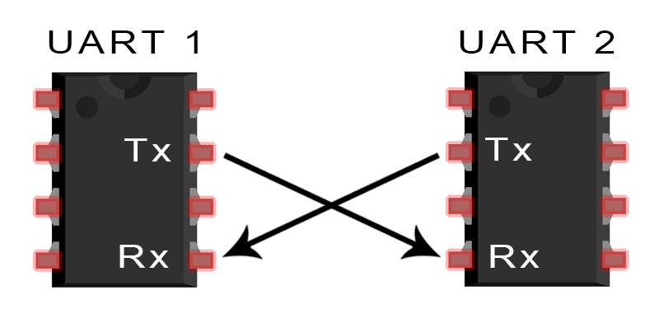
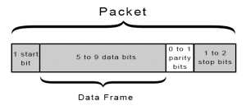
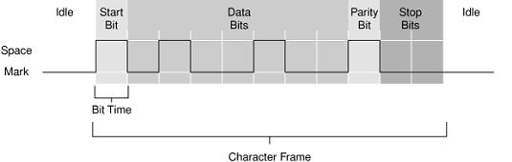
Serial Communication using UART
The most popular connection in hardware devices
What is the difference between UART, RS232 and RS485?

Slide 8
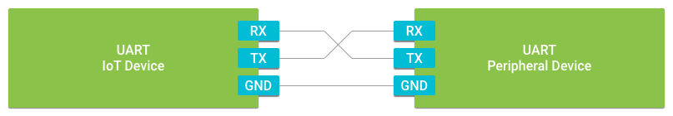
UART Device Driver on Android Things
UART stands for Universal Asynchronous Receiver Transmitter
It is universal because both the data transfer speed and data byte format are configurable.
It is asynchronous in that there are no clock signals present to synchronize the data transfer between the two devices
UART data transfer is full-duplex, meaning data can be sent and received at the same time

Slide 9
UART Implementation
https://github.com/androidthings/sample-uartloopback
Adding the required permission
Managing the connection
<uses-permission android:name="com.google.android.things.permission.USE_PERIPHERAL_IO" />
PeripheralManager manager = PeripheralManager.getInstance(); List<String> deviceList = manager.getUartDeviceList(); if (deviceList.isEmpty()) { Log.i(TAG, "No UART port available on this device."); } else { Log.i(TAG, "List of available devices: " + deviceList); }

Slide 10
UART Implementation
Open an UART Port
Close an UART Port
private UartDevice mDevice;
try { PeripheralManager manager = PeripheralManager.getInstance(); mDevice = manager.openUartDevice(UART_DEVICE_NAME); } catch (IOException e) { Log.w(TAG, "Unable to access UART device", e); }
@Override protected void onDestroy() { super.onDestroy(); if (mDevice != null) { try { mDevice.close(); mDevice = null; } catch (IOException e) { Log.w(TAG, "Unable to close UART device", e); } } }

Slide 11
UART Implementation
Configure the frame format
Baudrate: Communication speed in baud. In computer, it is equivalent to bits per second (bps)
public void configureUartFrame(UartDevice uart) throws IOException { // Configure the UART port uart.setBaudrate(115200); uart.setDataSize(8); uart.setParity(UartDevice.PARITY_NONE); uart.setStopBits(1); }

Slide 12
UART Implementation
Send a message
Receive a message
public void writeUartData(UartDevice uart) throws IOException { byte[] buffer = {...}; int count = uart.write(buffer, buffer.length); Log.d(TAG, "Wrote " + count + " bytes to peripheral"); }
private UartDeviceCallback mUartCallback = new UartDeviceCallback() { @Override public boolean onUartDeviceDataAvailable(UartDevice uart) { // Read available data from the UART device try { readUartBuffer(uart); } catch (IOException e) { Log.w(TAG, "Unable to access UART device", e); } return true; } @Override public void onUartDeviceError(UartDevice uart, int error) { Log.w(TAG, uart + ": Error event " + error); } };
public void readUartBuffer(UartDevice uart) throws IOException { // Maximum amount of data to read at one time final int maxCount = ...; byte[] buffer = new byte[maxCount]; int count; while ((count = uart.read(buffer, buffer.length)) > 0) { Log.d(TAG, "Read " + count + " bytes from peripheral"); } }

Slide 13
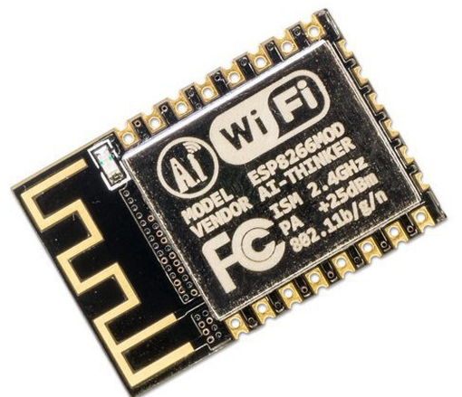
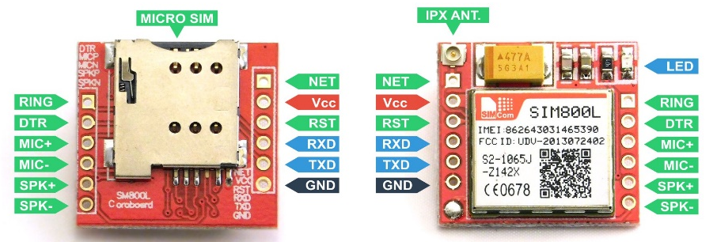
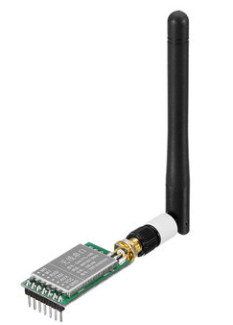
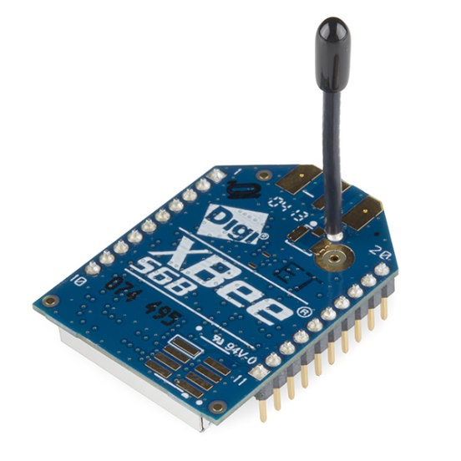
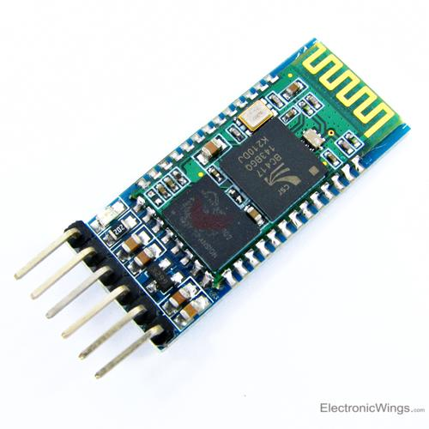
Wireless Modules using UART Interface
AT command (AT stands for attention)
Wifi
(ESP8266)
GSM/GPRS
LORA
(SX1728)
Bluetooth
XBee

Slide 14
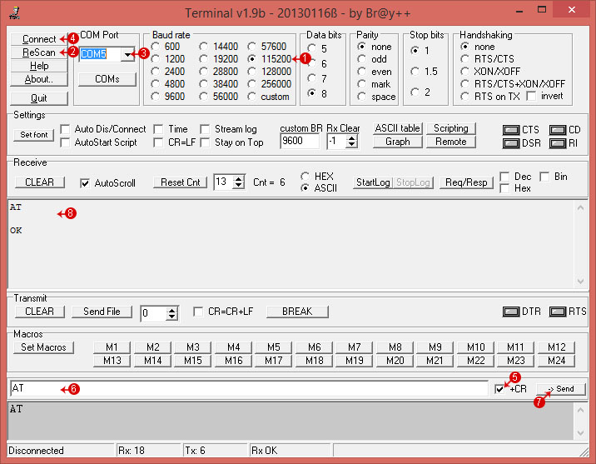
Hyper Terminal https://www.dropbox.com/s/7xuwege5pjv6fis/Terminal.exe?dl=0
1. Set Baudrate
3. Select COM Port
4. Click Connect
5. Send a testing command (AT)

Slide 15
Example AT Commands for GSM/GPRS
Send a SMS message to a phone:
AT+CMGF=1
AT+CSCS="GSM"
AT+CMGS="84906362340"
Send text message
0x1A
Send a GET request:
AT+SAPBR=1,1
AT+HTTPINIT
AT+HTTPPARA="CID",1
AT+HTTPPARA="URL","http://www.iforce2d.net/test.php"
AT+HTTPACTION=0
AT+HTTPREAD
AT+HTTPTERM
Note: Every AT command ends with carry return
\r\n
0x0d 0x0a

Slide 16
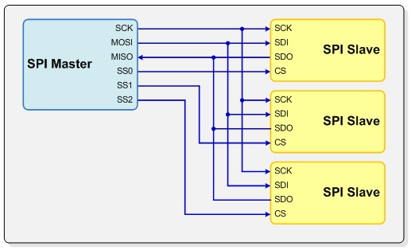
Serial Communication using SPI
Serial Peripheral Interface (SPI) is an interface bus commonly used to send data between microcontrollers and small peripherals such as shift registers, sensors, and SD cards
Separate clock (SCK), data lines (MISO, MOSI) and chip select (CS) are used.
Synchronous protocol

Slide 17
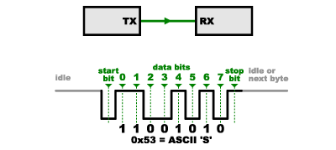
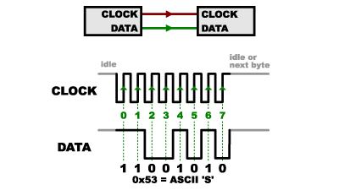
Asynchronous vs Synchronous Protocol
Asynchronous (UART):
There is no CLOCK
Clock drift issue → low speed
Synchronous (SPI):
There is a CLOCK line
High speed

Slide 18
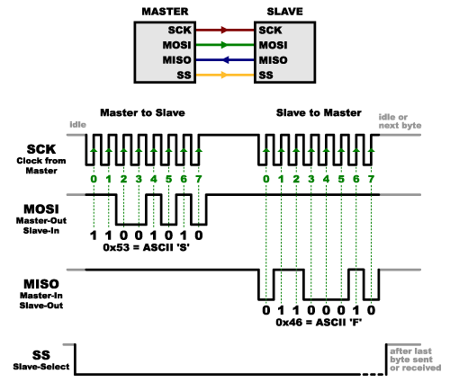
SPI Protocol
Clock is generated by the master

Slide 19
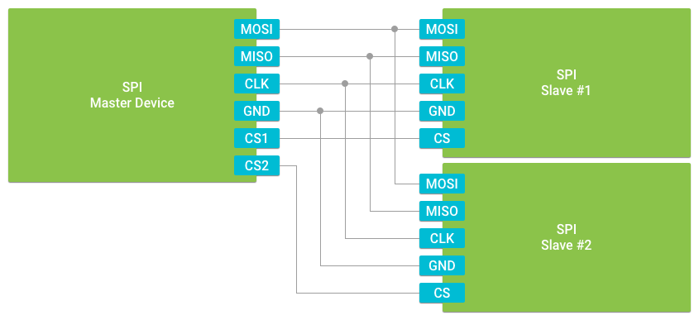
SPI Device Driver on Android Things
Serial Peripheral Interface (SPI) devices are typically found where fast data transfer rates are required (e.g. external non-volatile memory and graphical displays)
Clock speeds are typically in the 16MHz to 25MHz range.

Slide 20
Implement SPI
Adding the required permission
Managing the device connection
<uses-permission android:name="com.google.android.things.permission.USE_PERIPHERAL_IO" />
PeripheralManager manager = PeripheralManager.getInstance(); List<String> deviceList = manager.getSpiBusList(); if (deviceList.isEmpty()) { Log.i(TAG, "No SPI bus available on this device."); } else { Log.i(TAG, "List of available devices: " + deviceList); }

Slide 21
Implementation SPI
Open SPI Port
Close SPI Port
try { PeripheralManager manager = PeripheralManager.getInstance(); mDevice = manager.openSpiDevice(SPI_DEVICE_NAME); } catch (IOException e) { Log.w(TAG, "Unable to access SPI device", e); }
@Override protected void onDestroy() { super.onDestroy(); if (mDevice != null) { try { mDevice.close(); mDevice = null; } catch (IOException e) { Log.w(TAG, "Unable to close SPI device", e); } } }

Slide 22
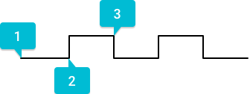
Implement SPI
Configure SPI connection
MODE0: Clock signal idles low, data is transferred on the leading clock edge
MODE1: Clock signal idles low, data is transferred on the trailing clock edge
MODE2: Clock signal idles high, data is transferred on the leading clock edge
MODE3: Clock signal idles high, data is transferred on the trailing clock edge
public void configureSpiDevice(SpiDevice device) throws IOException { // Low clock, leading edge transfer device.setMode(SpiDevice.MODE0); // 16MHz, 8BPW, MSB first device.setFrequency(16000000); device.setBitsPerWord(8); device.setBitJustification(SpiDevice.BIT_JUSTIFICATION_MSB_FIRST); }

Slide 23
Implement SPI
Transferring and Receiving Data
If 2 bytes are sent and 2 bytes will be received, how many bytes for the buffer (the second parameter in sendCommand function)???
public void sendCommand(SpiDevice device, byte[] buffer) throws IOException { // Shift data out to slave device.write(buffer, buffer.length); // Read the response byte[] response = new byte[32]; device.read(response, response.length); ... }

Slide 24
Serial Communication using I2C
Inter-integrated Circuit (I²C) Protocol is a protocol intended to allow multiple “slave” digital integrated circuits (“chips”) to communicate with one or more “master” chips.
Like the Serial Peripheral Interface (SPI), it is only intended for short distance communications within a single device.
Like Asynchronous Serial Interfaces (such as RS-232 or UARTs), it only requires two signal wires to exchange information.

Slide 25
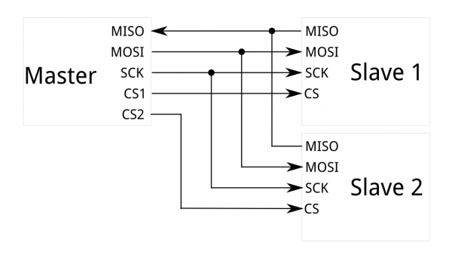
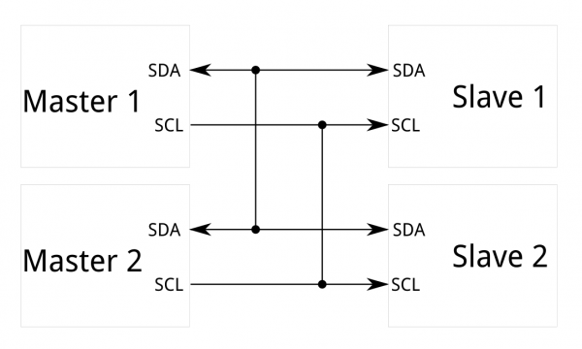
I2C vs SPI
Number of pins → Difficult in tight PCB layout
SPI only allows one master on the bus
SPI is good for high data rate full-duplex
Only two pins, like asynchronous serial, but can support up to 128 slave devices
Support a multi-master system
Data rates is at 100kHz or 400kHz

Slide 26
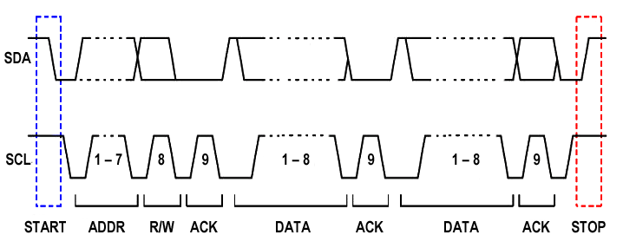
I2C Protocol
Master sends START condition and controls the clock (SCL)
Master sends a unique 7-bit slave address
Master sends Read/Write bit: 0 write to slave, 1: read from slave
Slave which address is matched send ACK bit
Data (8bit) is transfered

Slide 27
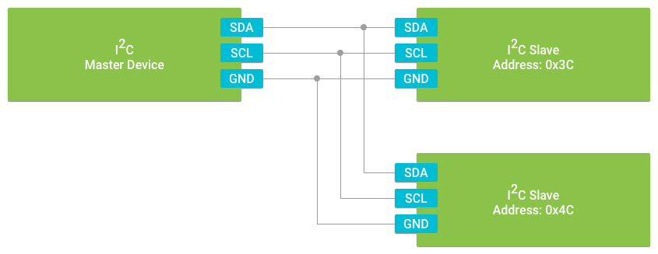
Implement I2C
I2C is a synchronous serial interface. The device in control of triggering the clock signal is known as the master. All other connected peripherals are known as slaves. Each device is connected to the same set of data signals to form a bus.
https://developer.android.com/things/sdk/pio/i2c

Slide 28
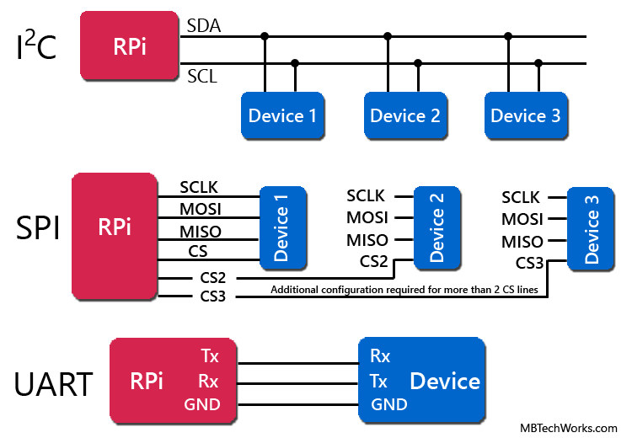
Summary
UART = Universal Asynchronous Receiver / Transmitter
SPI = Serial Peripheral Interface
I²C = Inter-Integrated Circuit

Slide 29
Serial Communications Methods
Name | Description | Function
I²C | Inter-Integrated Circuit | Half duplex, serial data transmission used for short-distance between boards, modules and peripherals. Uses 2 pins.
SPI | Serial Peripheral Interface bus | Full-duplex, serial data transmission used for short-distance between devices. Uses 4 pins.
UART | Universal Asynchronous Receiver-Transmitter | Full-duplex, Asynchronous, serial data transmission between devices. Uses 2 pins.

Slide 30
Conclusion
UART - simple; not high speed; no clock needed; limited to one device connected to the Pi.
I2C - faster than UART, but not as fast as SPI; easier to chain many devices; Pi drives the clock so no sync issues.
SPI - fastest of the three; Pi drives the clock so no sync issues; practical limit to number of devices on the Pi.

